Slide 1

Malan Christiansen
Portfolio Assignment

Slide 2
Overview of website
Home
About
Projects
Blog
Contacts
Resume

Slide 3
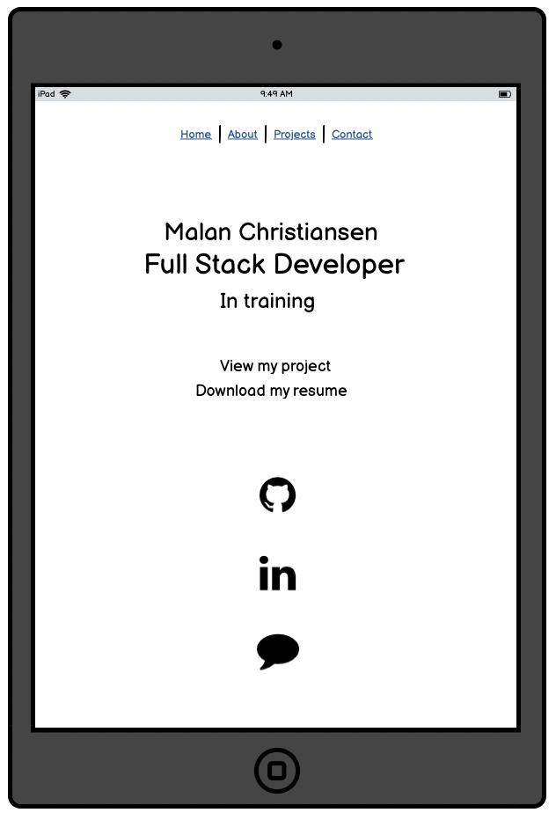
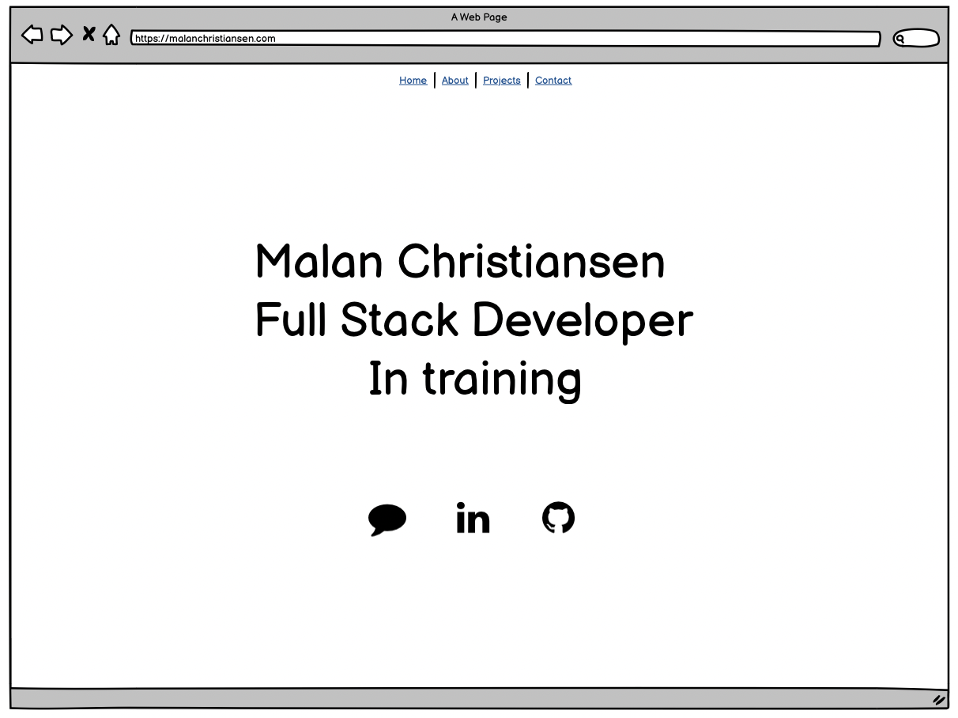
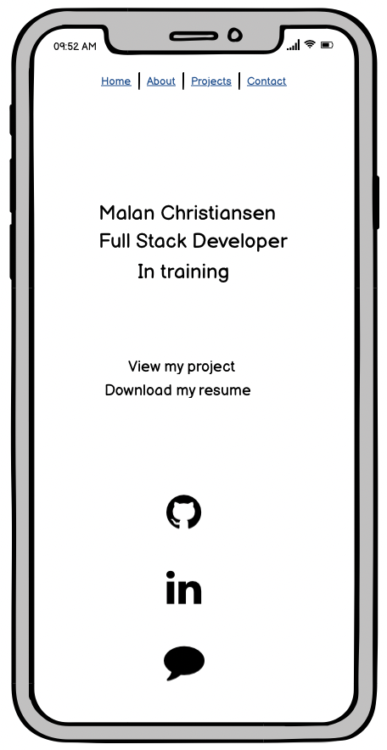
Wireframes Home

Slide 4
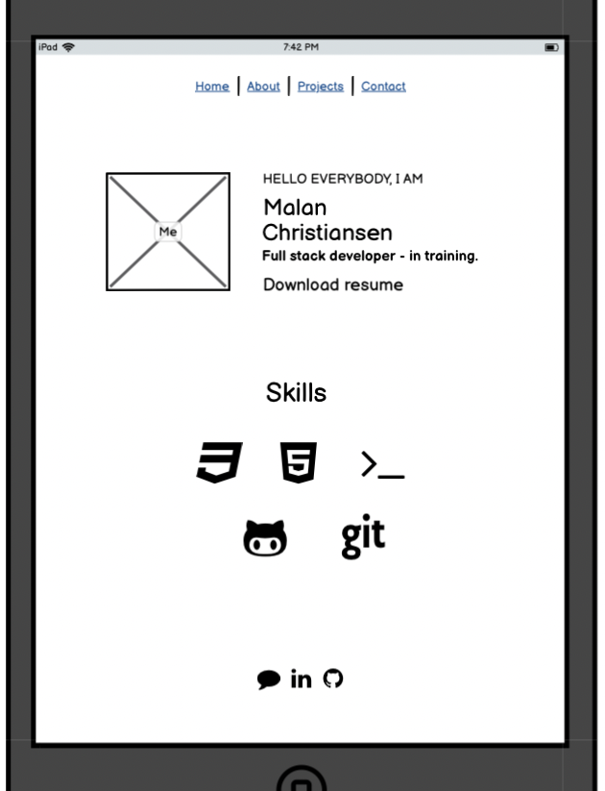
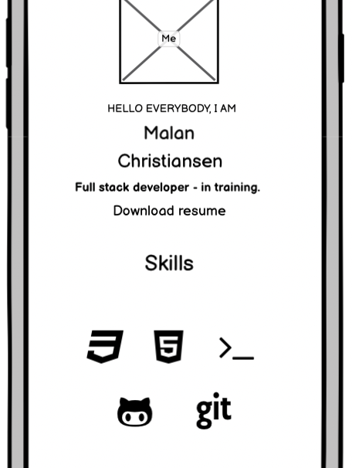
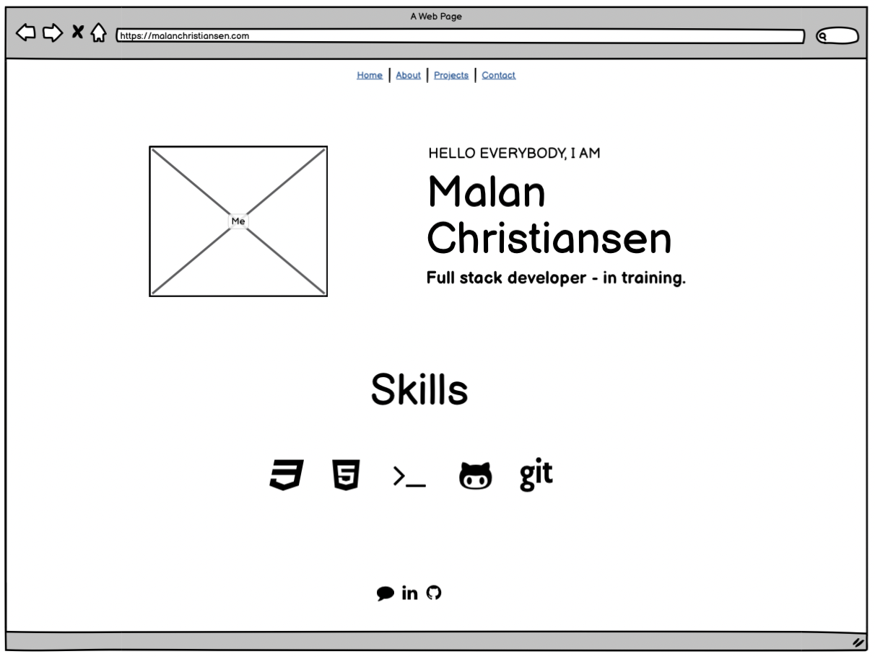
Wireframes About

Slide 5
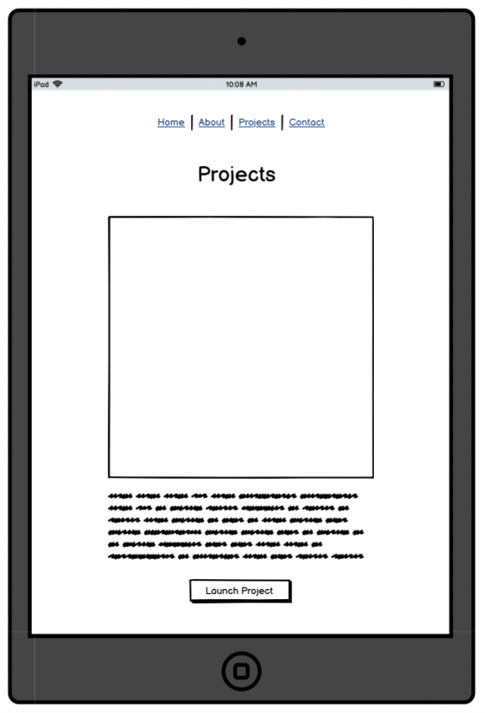
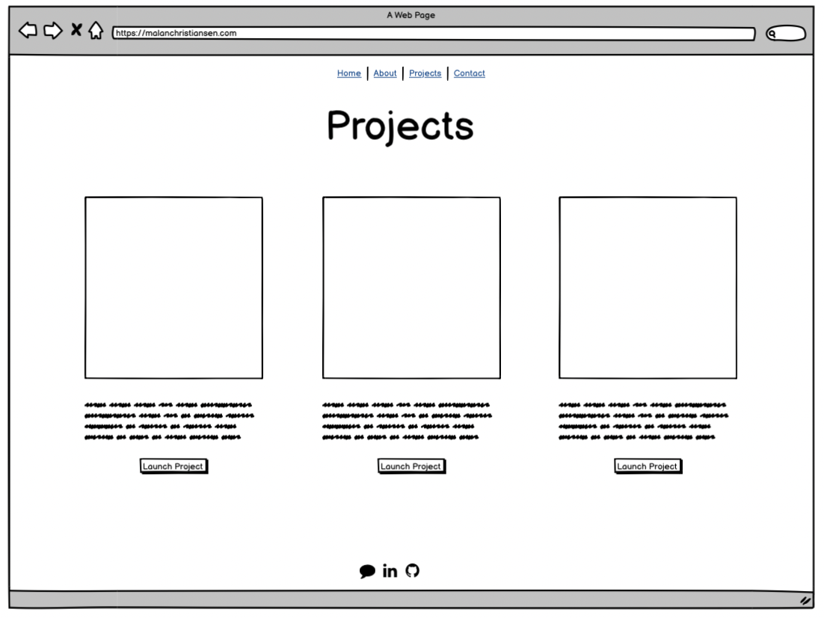
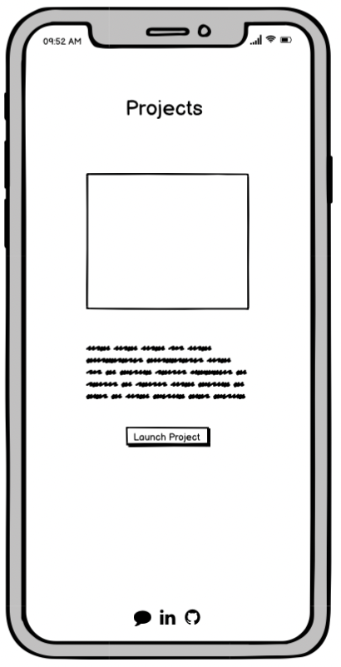
Wireframes Projects

Slide 6
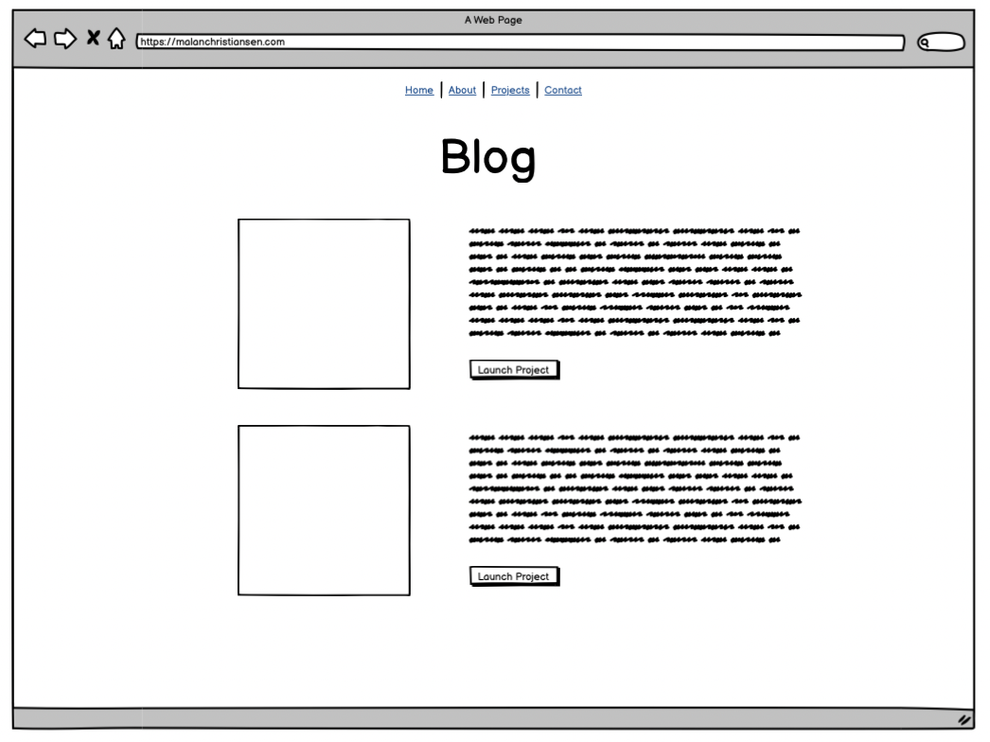
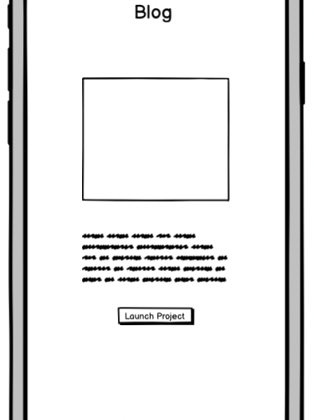
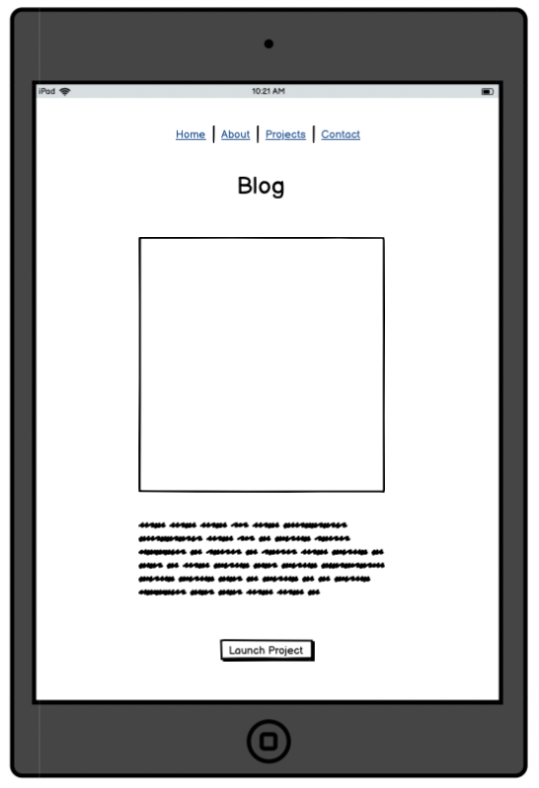
Wireframes Blog

Slide 7
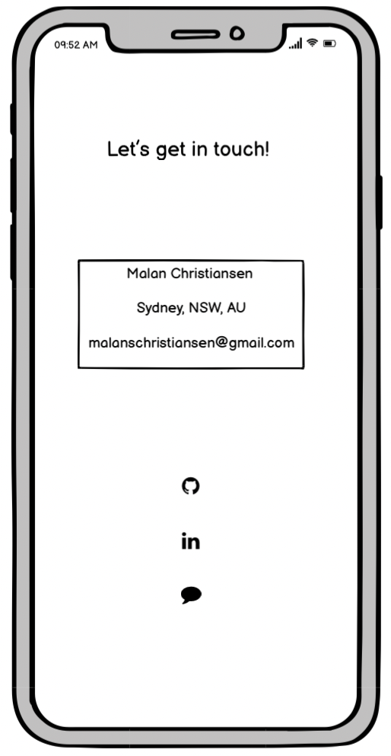
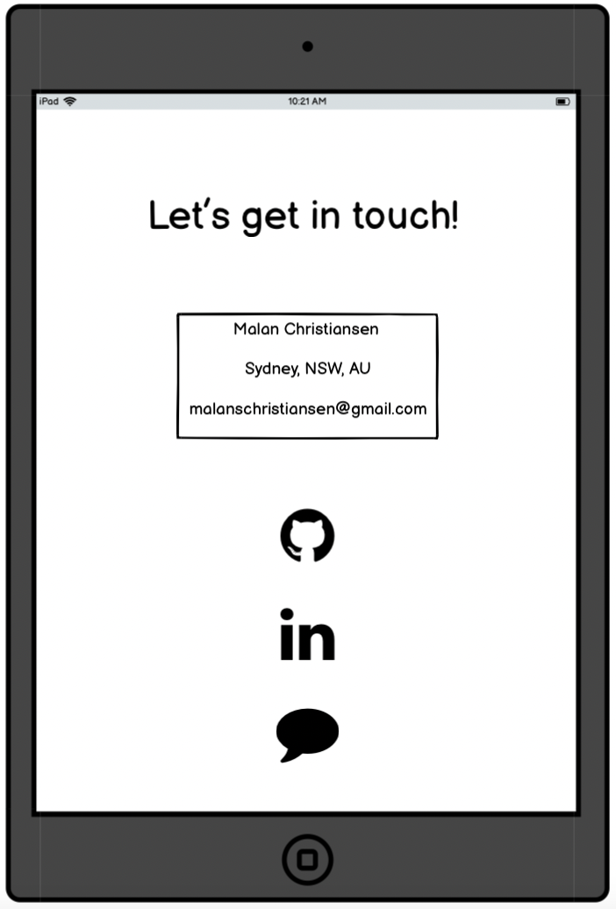
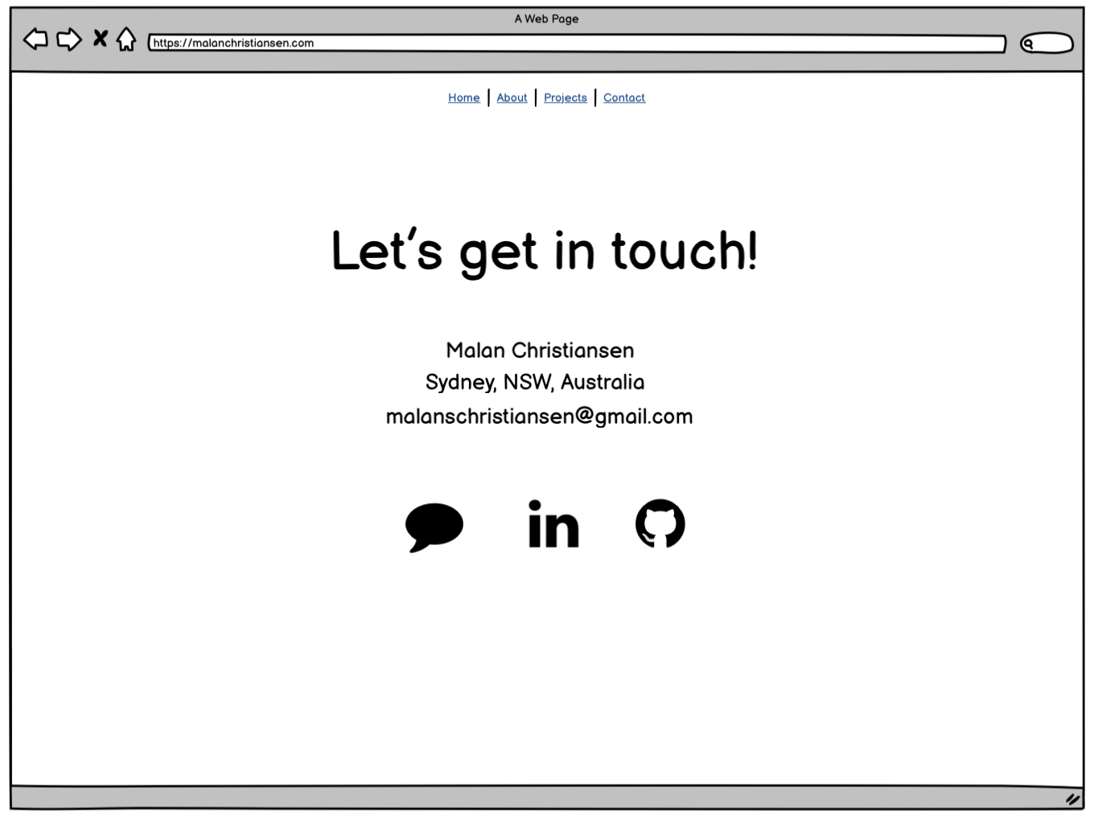
Wireframes Contact

Slide 8
Components
Home: Big clickable icons for LinkedIn, Github, Email
About me: Profile picture, link to resume, footer with icons
Projects: Cards incl. image, project explanation, link to project
Blogs: Cards incl. image, post, date, link to post
Contact: Box with address and email, Big clickable icons for LinkedIn, Github, Email

Slide 9
Walk through of website

Slide 10
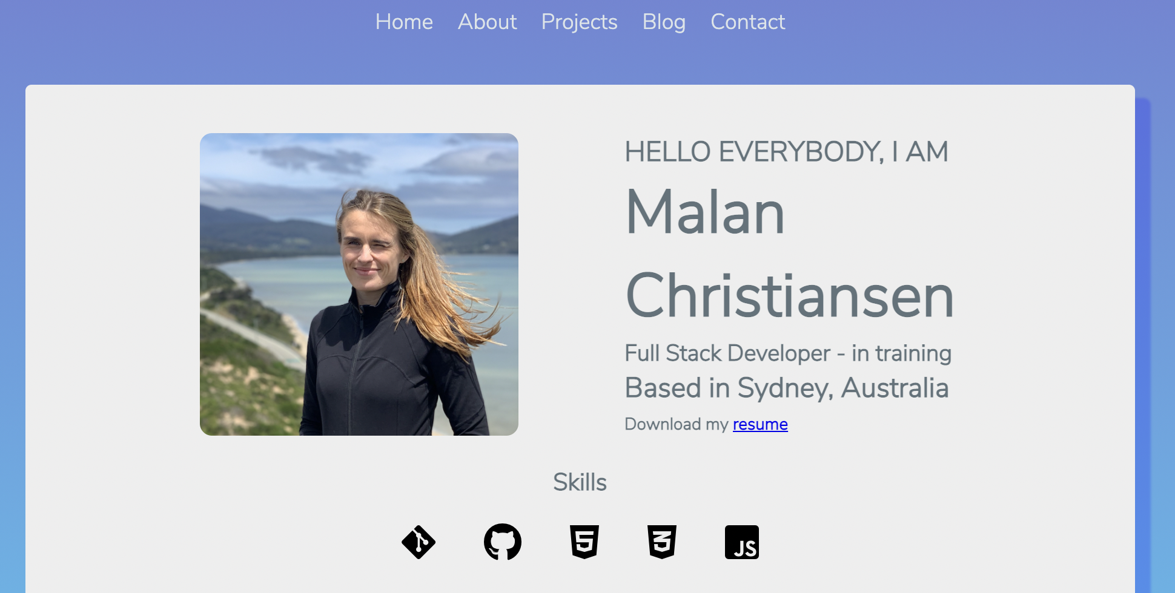

Slide 11
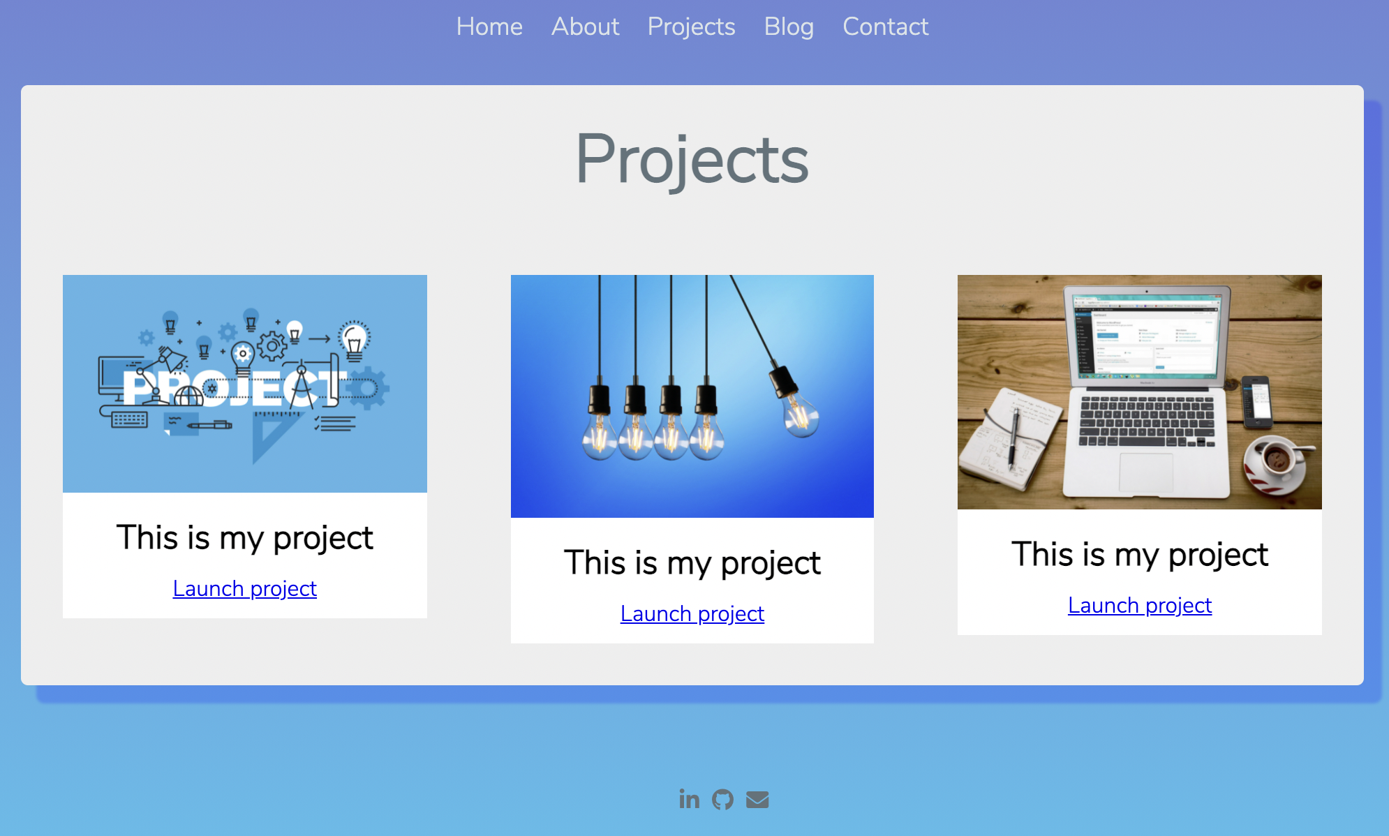

Slide 12
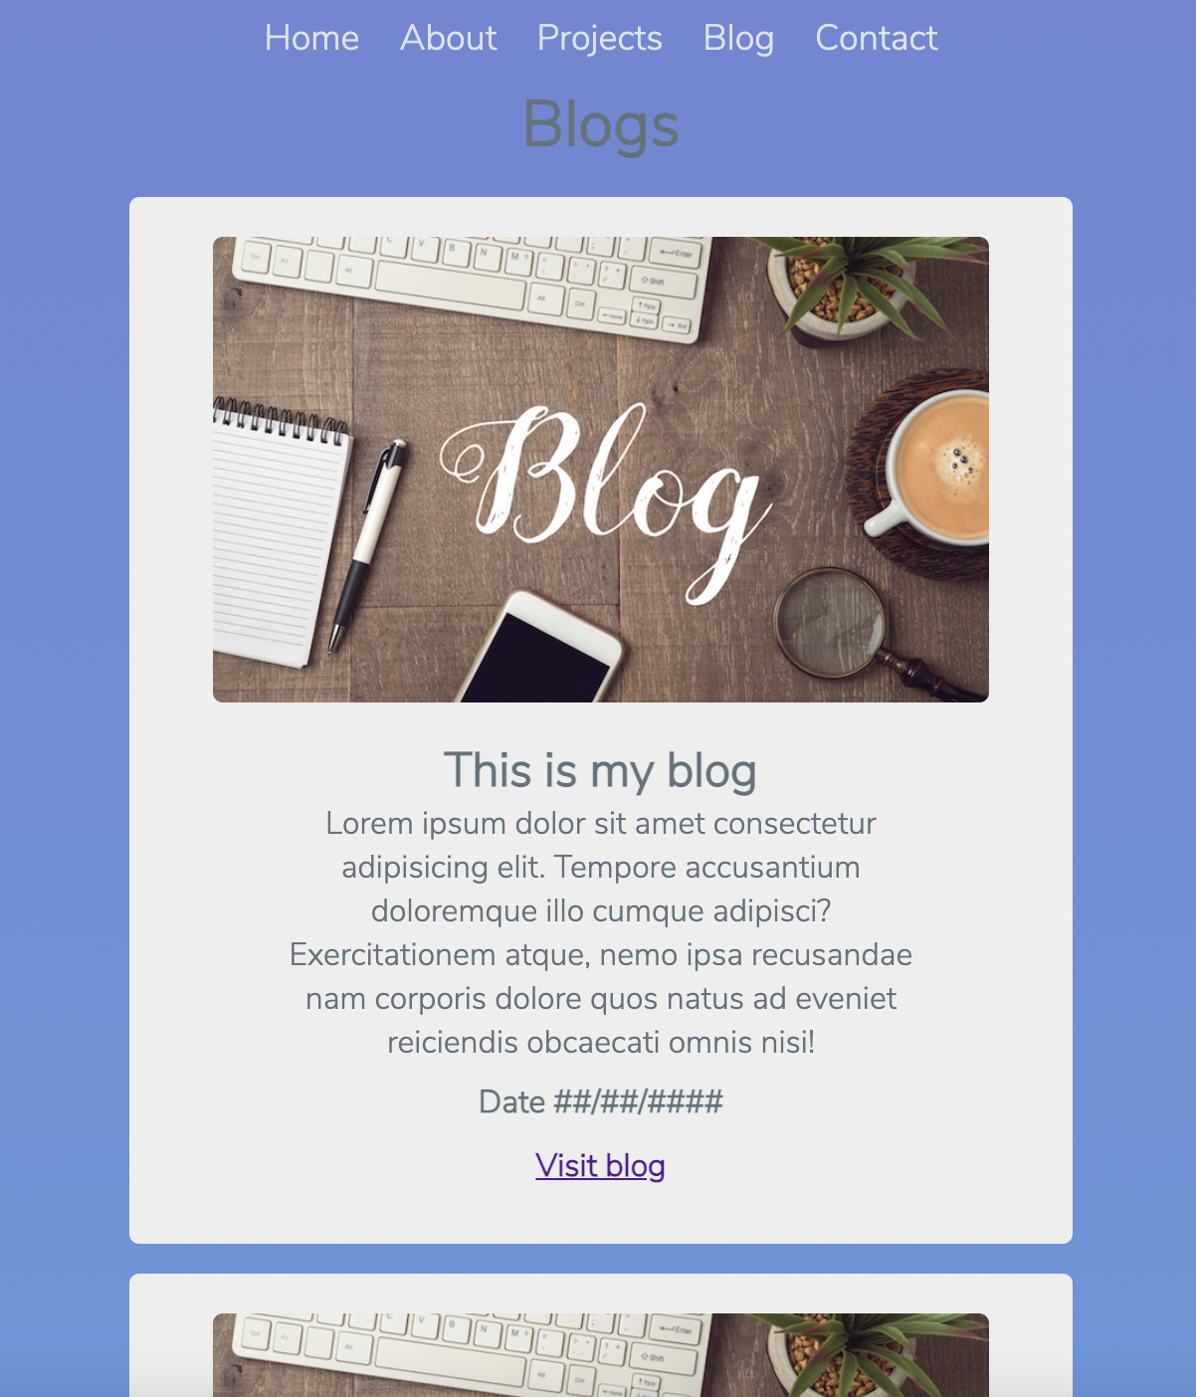

Slide 13
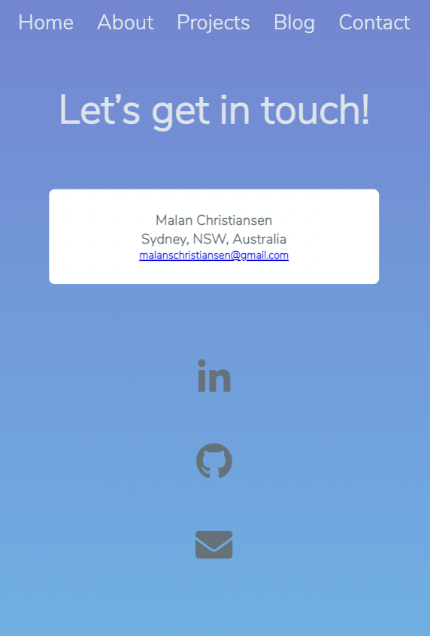

Slide 14
Challenges and Favorite part
Flexbox
Mobile First
Sass
Building from scratch

Slide 15
Design and Decisions
Font style
Colors
Icons
Simple

Slide 16
Thank you!

